Slide 1
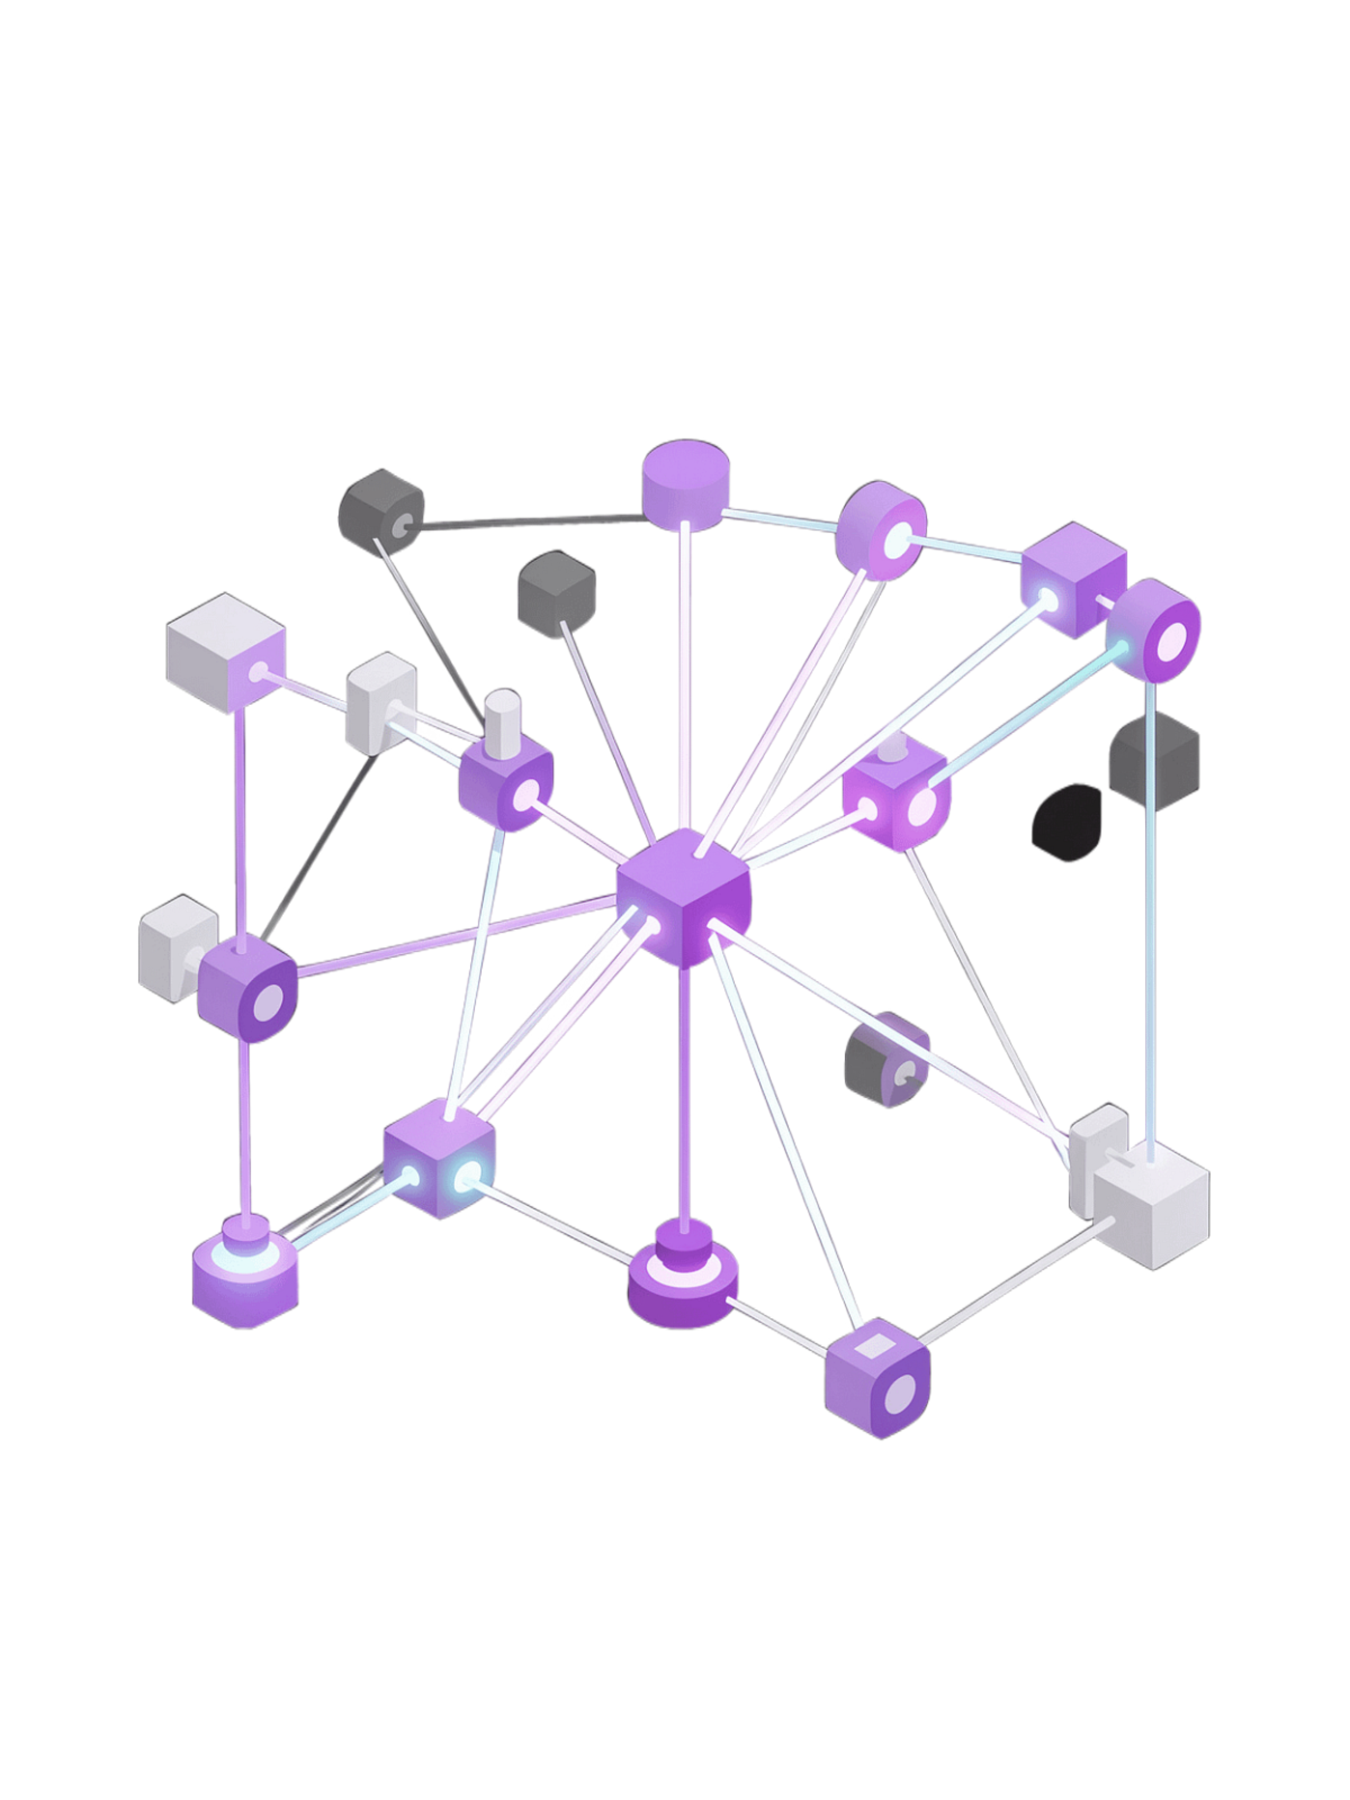
Natural Language Processing
Teaching Machines to Understand Human Language

Slide 2
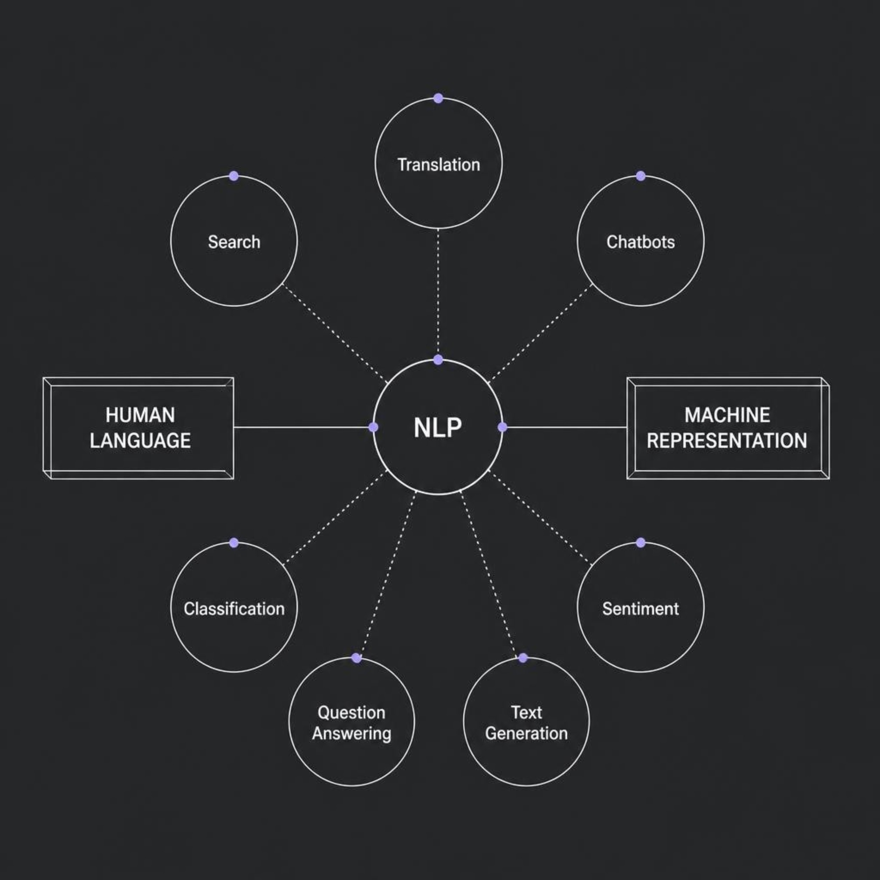
What Is Natural Language Processing?
NLP bridges two fundamentally different worlds — human language with all its nuance, ambiguity, and meaning, and machine representations built on numbers, vectors, and patterns.
NLP combines linguistics, statistics, machine learning, and deep learning to solve tasks like translation, search, chatbots, classification, sentiment analysis, question answering, and text generation.
Real Example: Intent Detection
Real Example: Sentiment
"Book me a flight to Delhi" → Intent: Flight Booking
"The movie was amazing!" → Sentiment: Positive

Slide 3
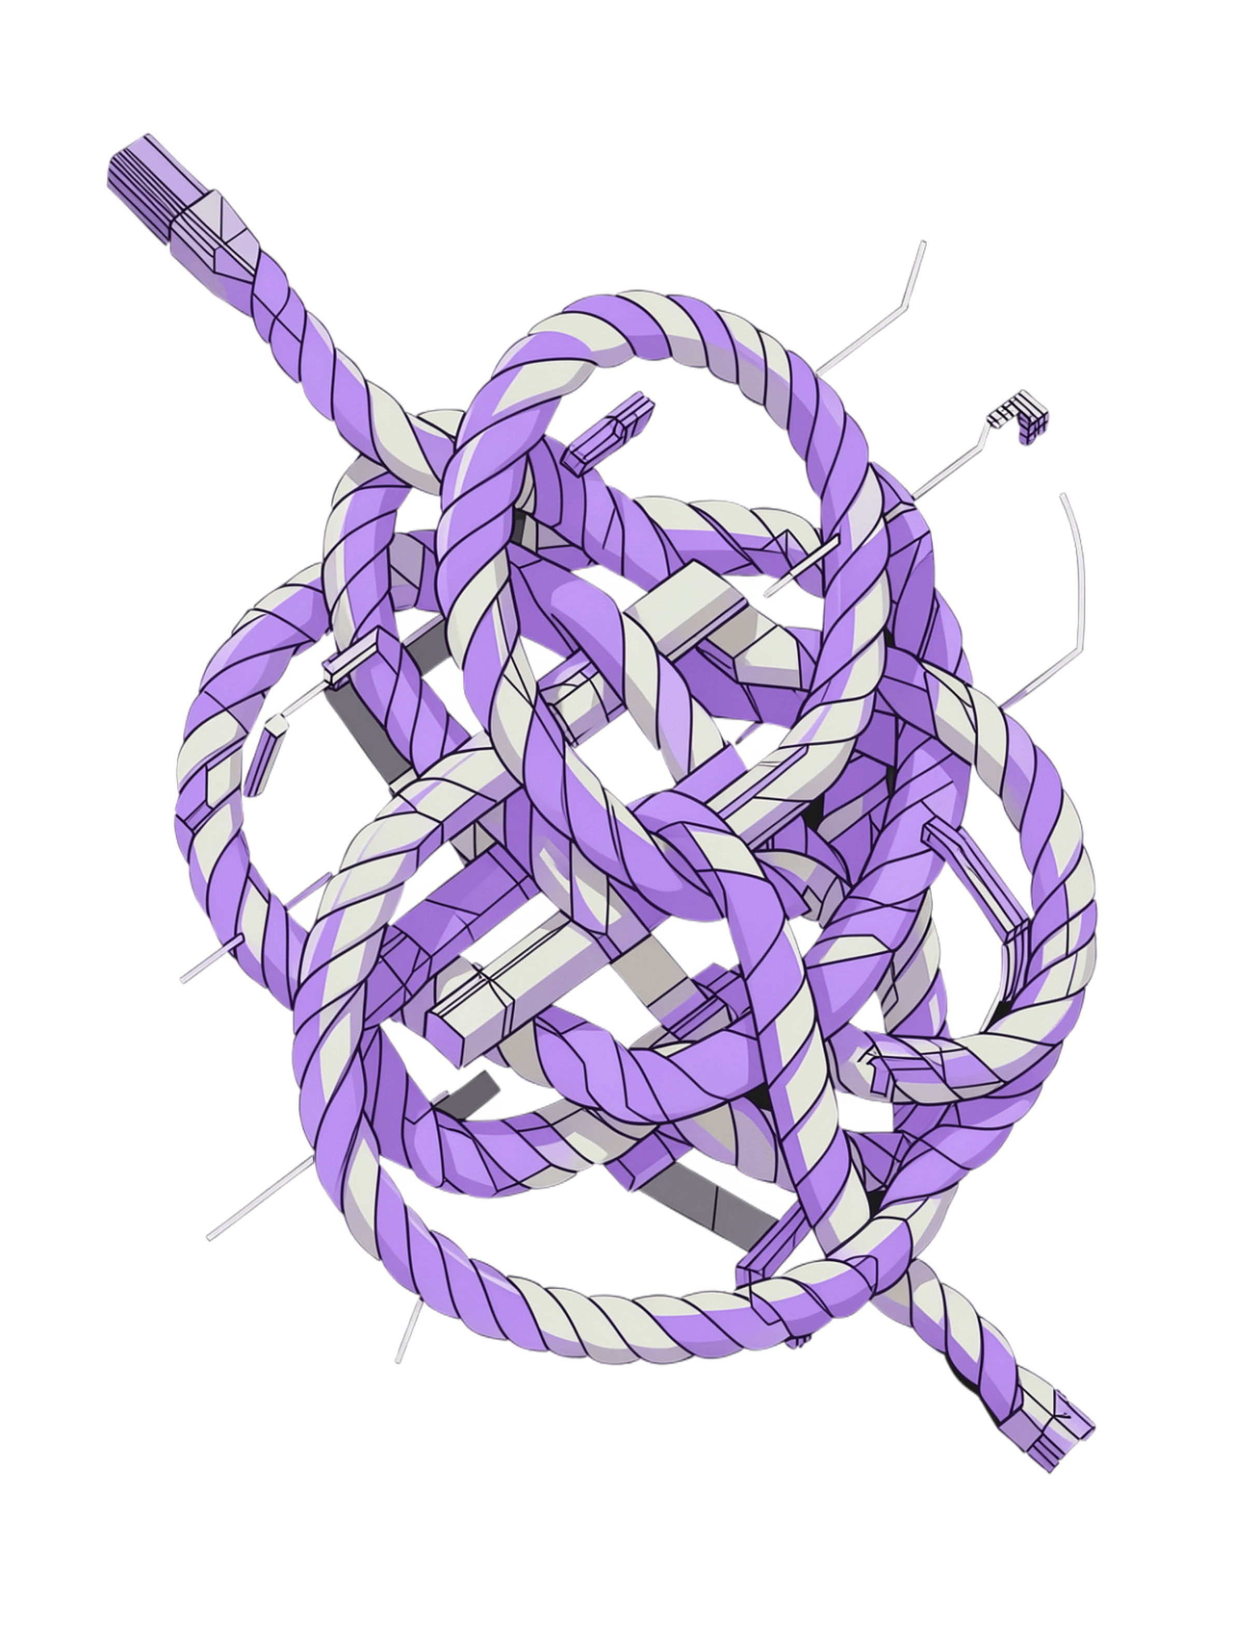

Why Is Human Language Hard?
🔀 Ambiguity
"Bank" = financial institution OR river bank. Same word, completely different meanings.
🎭 Sarcasm & Tone
"Great job!" can be genuine praise or sarcasm. "I am fine" — okay or not?
↔ Word Order
"Dog bites man" ≠ "Man bites dog" — same words, opposite events.
🚫 Negation
"I liked it" vs "I did NOT like it" — opposite meanings, one word difference.
NLP systems must simultaneously process: Words + Order + Context + Meaning + Relationships — all at once.

Slide 4
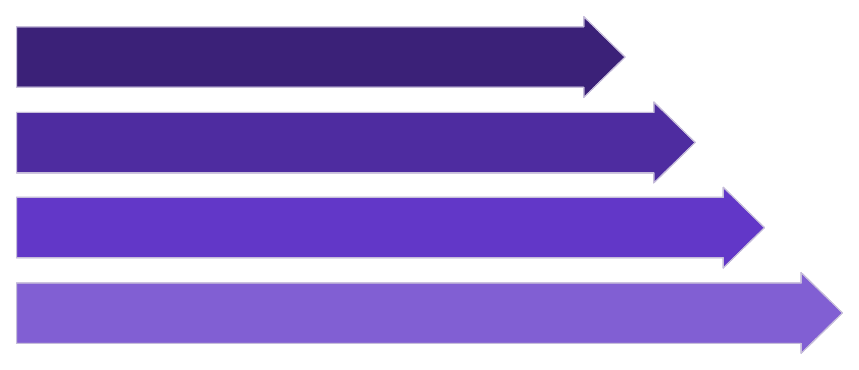
Text Preprocessing: Clean Before Learning
The Raw Input
"OMG!!! The movie was AMAZING!!! 😍 I loved it."
Before any model can learn, raw text must be prepared through a sequential pipeline of transformations.
Lowercase
Lowercasing: Normalize case variations
Symbol removal: Strip noise (!!!, URLs, HTML tags)
Tokenization: Split into meaningful units
Stop-word handling: Optionally remove common words
Remove Symbols
Tokenize
Clean Tokens
Key insight: Preprocessing is task-dependent. Modern NLP often preserves emojis, negation, and capitalization that older pipelines discarded.

Slide 5



Tokenization, Stemming & Lemmatization
Three distinct operations — often confused, but fundamentally different in purpose and output.
Tokenization
Stemming
Lemmatization
"Machine learning is powerful"
→ ["Machine", "learning", "is", "powerful"]
Splits text into units. Modern Transformers use subword tokenization.
"playing, played, plays"
→ "play"
Rough root form. Fast but may produce non-dictionary words.
"running, ran, runs"
→ "run"
Linguistically correct base form. Slower, more accurate, uses vocabulary knowledge.
Key Distinction: Tokenization ≠ Stemming ≠ Lemmatization — each solves a different problem in the NLP pipeline.

Slide 6
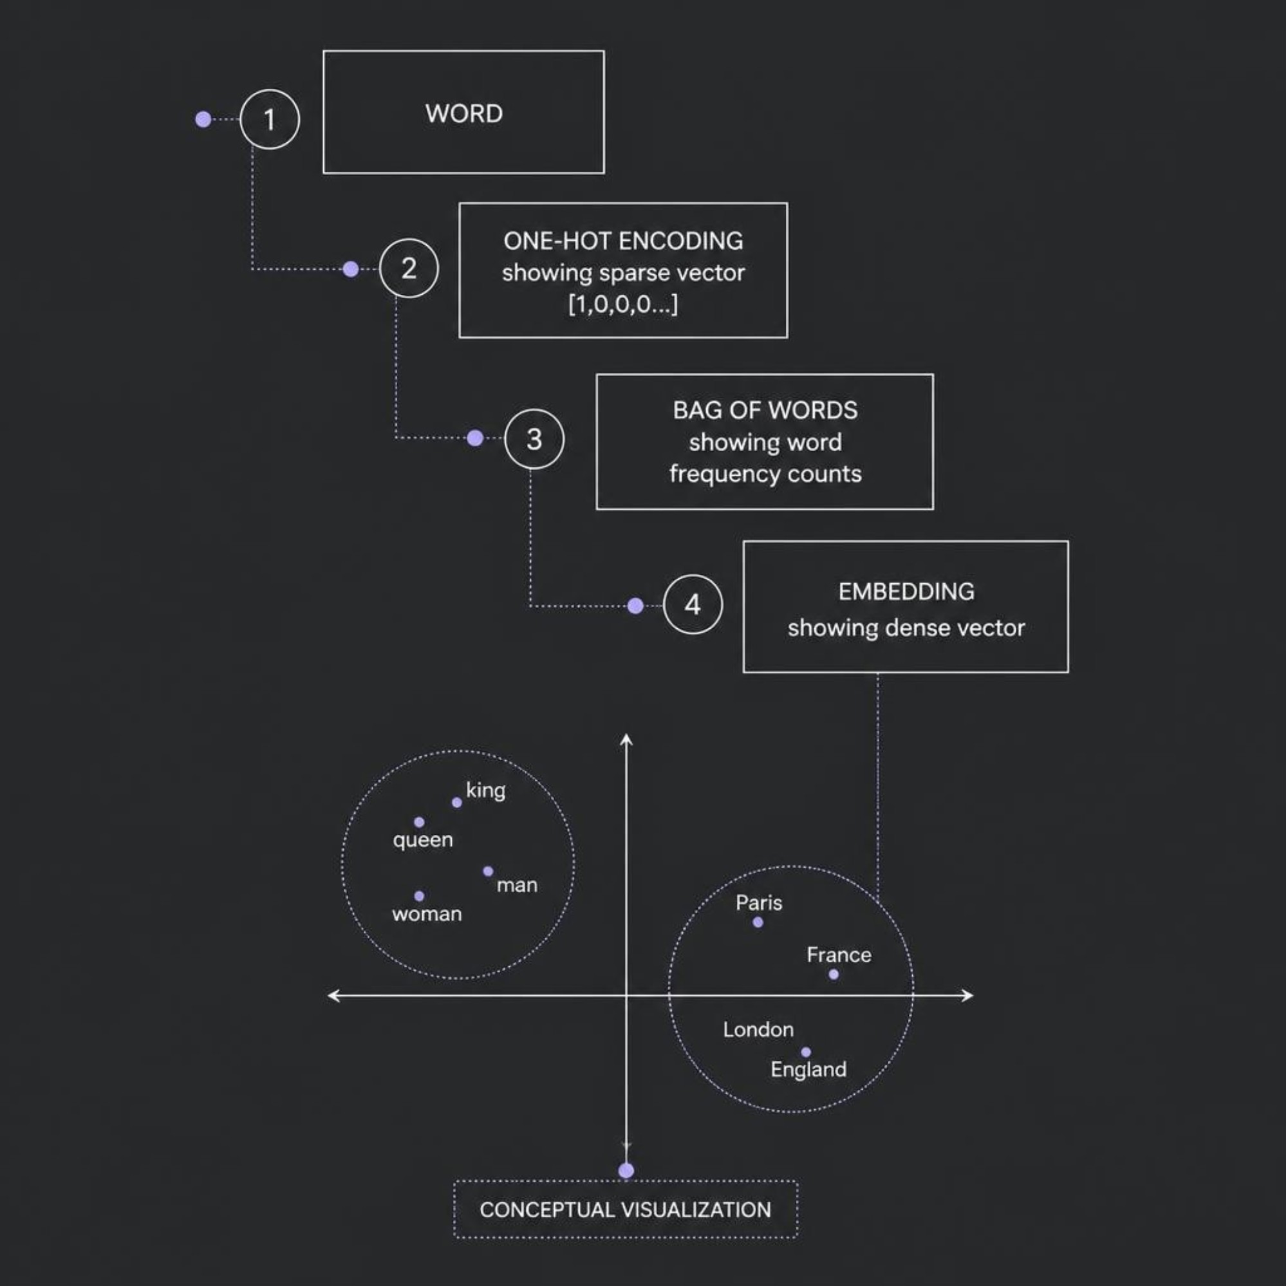
From Words to Numbers
The Core Problem
Machine learning models operate on numerical representations, not raw text. The challenge: how do we encode meaning mathematically?
1
One-Hot Encoding
2
Bag of Words / TF-IDF
3
Word Embeddings
"cat" → [1,0,0,0…] | "dog" → [0,1,0,0…]. Words treated as unrelated symbols. No semantic structure.
Word occurrence and importance scores. Captures frequency but not meaning or word relationships.
Dense vectors where related words cluster together in representation space. "king" is close to "queen"; "Paris" close to "France".

Slide 7
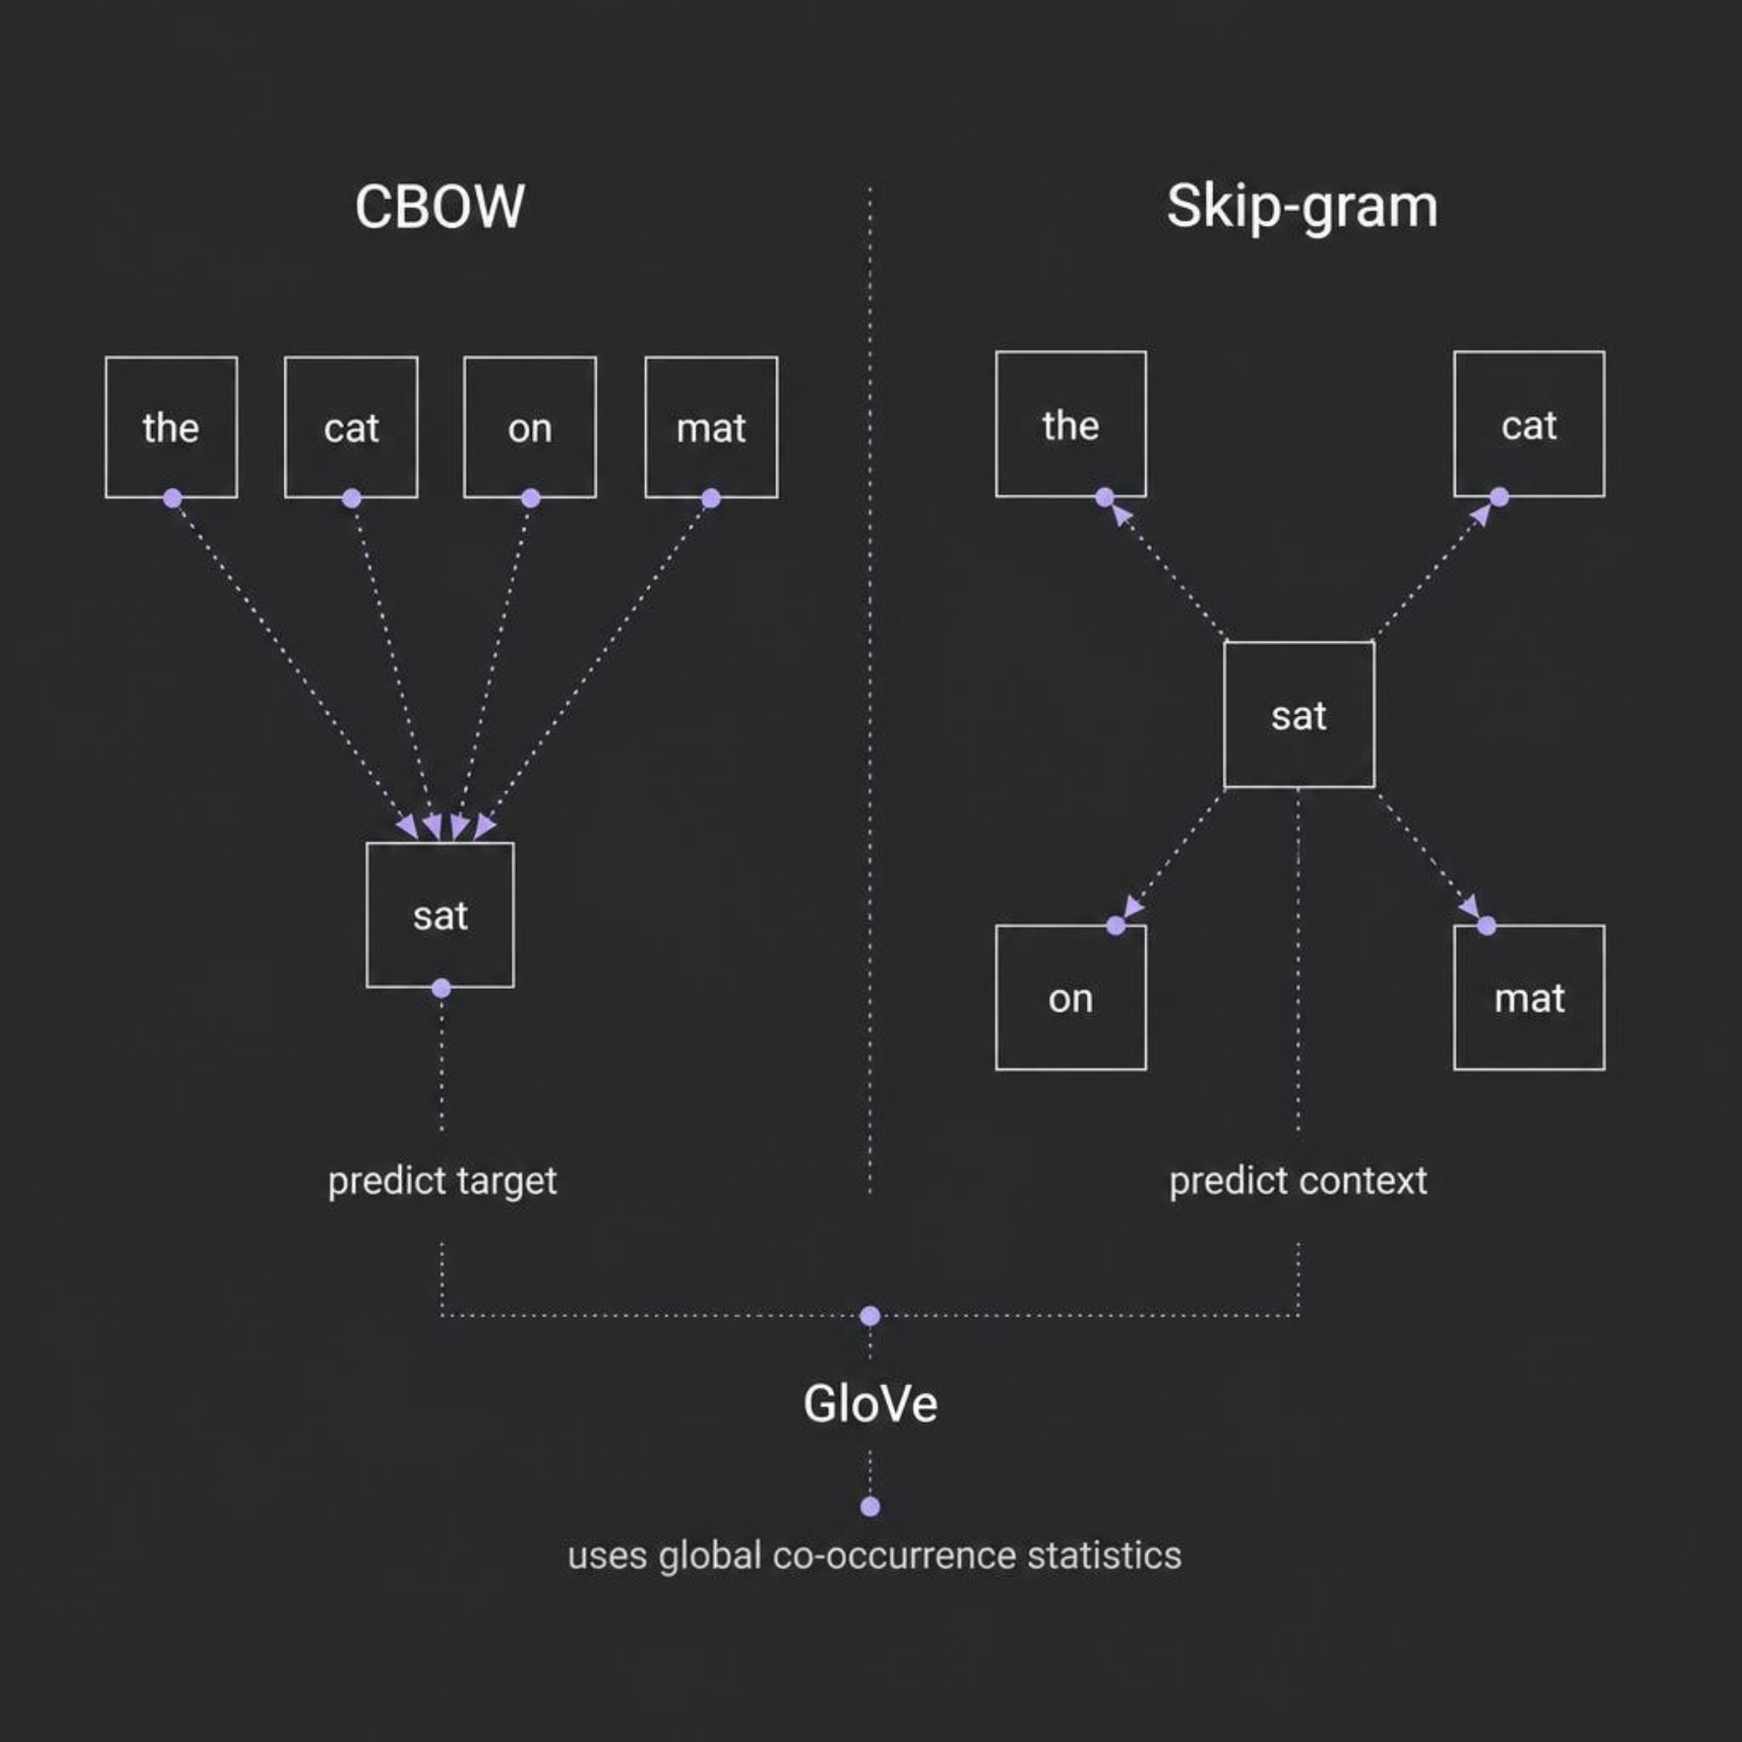

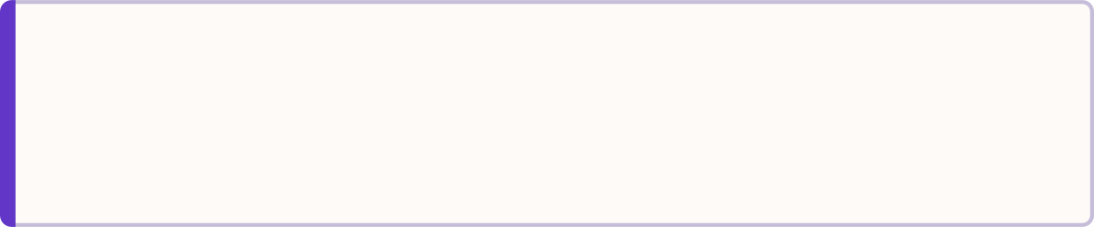

Word Embeddings: Word2Vec & GloVe
The Central Idea
Words used in similar contexts have related vector representations. Two architectures, two directions of prediction:
Modern context: Transformers use contextual token representations, not static word embeddings alone.
CBOW — Context → Word
Skip-gram — Word → Context
GloVe — Global Statistics
"The cat ___ on the mat" → predicts "sat"
"sat" → predicts "cat, mat, the…"
Learns from global word co-occurrence matrix across entire corpus.

Slide 8

Transformers & Contextual Understanding
Why Transformers Changed Everything
Input Tokens
Embeddings
RNNs process text step-by-step — slow and limited in capturing long-range dependencies. Transformers process all tokens in parallel using self-attention.
Raw words fed in as parallel tokens.
Token vectors plus positional signals added.
Self-Attention in Action
"The animal didn't cross the street because it was tired."
Self-attention allows the model to connect "it" directly to "animal" — regardless of how many words separate them. Every token attends to every other token simultaneously.
Self-Attention
Feed-Forward
All-to-all token interactions compute attention.
Per-token MLPs transform contextualized features.
Tokens
Embeddings
Self-Attention
Feed-Forward
Output

Slide 9
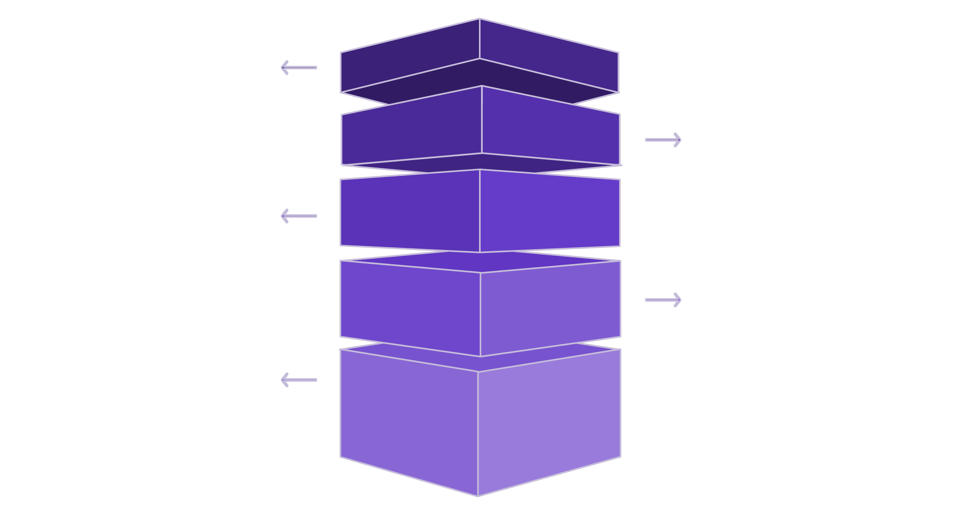


BERT vs GPT: Two Transformer Families
🔵 BERT — Encoder
🟣 GPT — Decoder
Bidirectional context: reads left-to-right AND right-to-left simultaneously. Understands full sentence context before making predictions.
Primary uses: Text classification, Named Entity Recognition, Question Answering, Semantic Search
Architecture orientation: Understanding
Autoregressive generation: reads left-to-right only, predicting the next token at each step.
Primary uses: Text generation, Code generation, Conversational AI, Summarization
Architecture orientation: Generation
Understanding
Bidirectional context across tokens.
Generation
Decoder Block 1
Encoder Block 1
Autoregressive left-to-right token generation.
Processes previous tokens and passes context rightward.
Bottom encoder with bidirectional arrows.
Encoder Block 2
Middle encoder with bidirectional arrows.
Encoder Block 3
Top encoder with bidirectional arrows.
Decoder Block 2
Decoder Block 3
Use Cases
Builds on earlier context, refining predictions sequentially.
Final layer produces next-token probabilities for output.
Classification, NER, Question Answering.
Important nuance: BERT can generate; GPT can understand. These are primary use cases, not absolute architectural limitations. Both are built on the Transformer foundation.

Slide 10
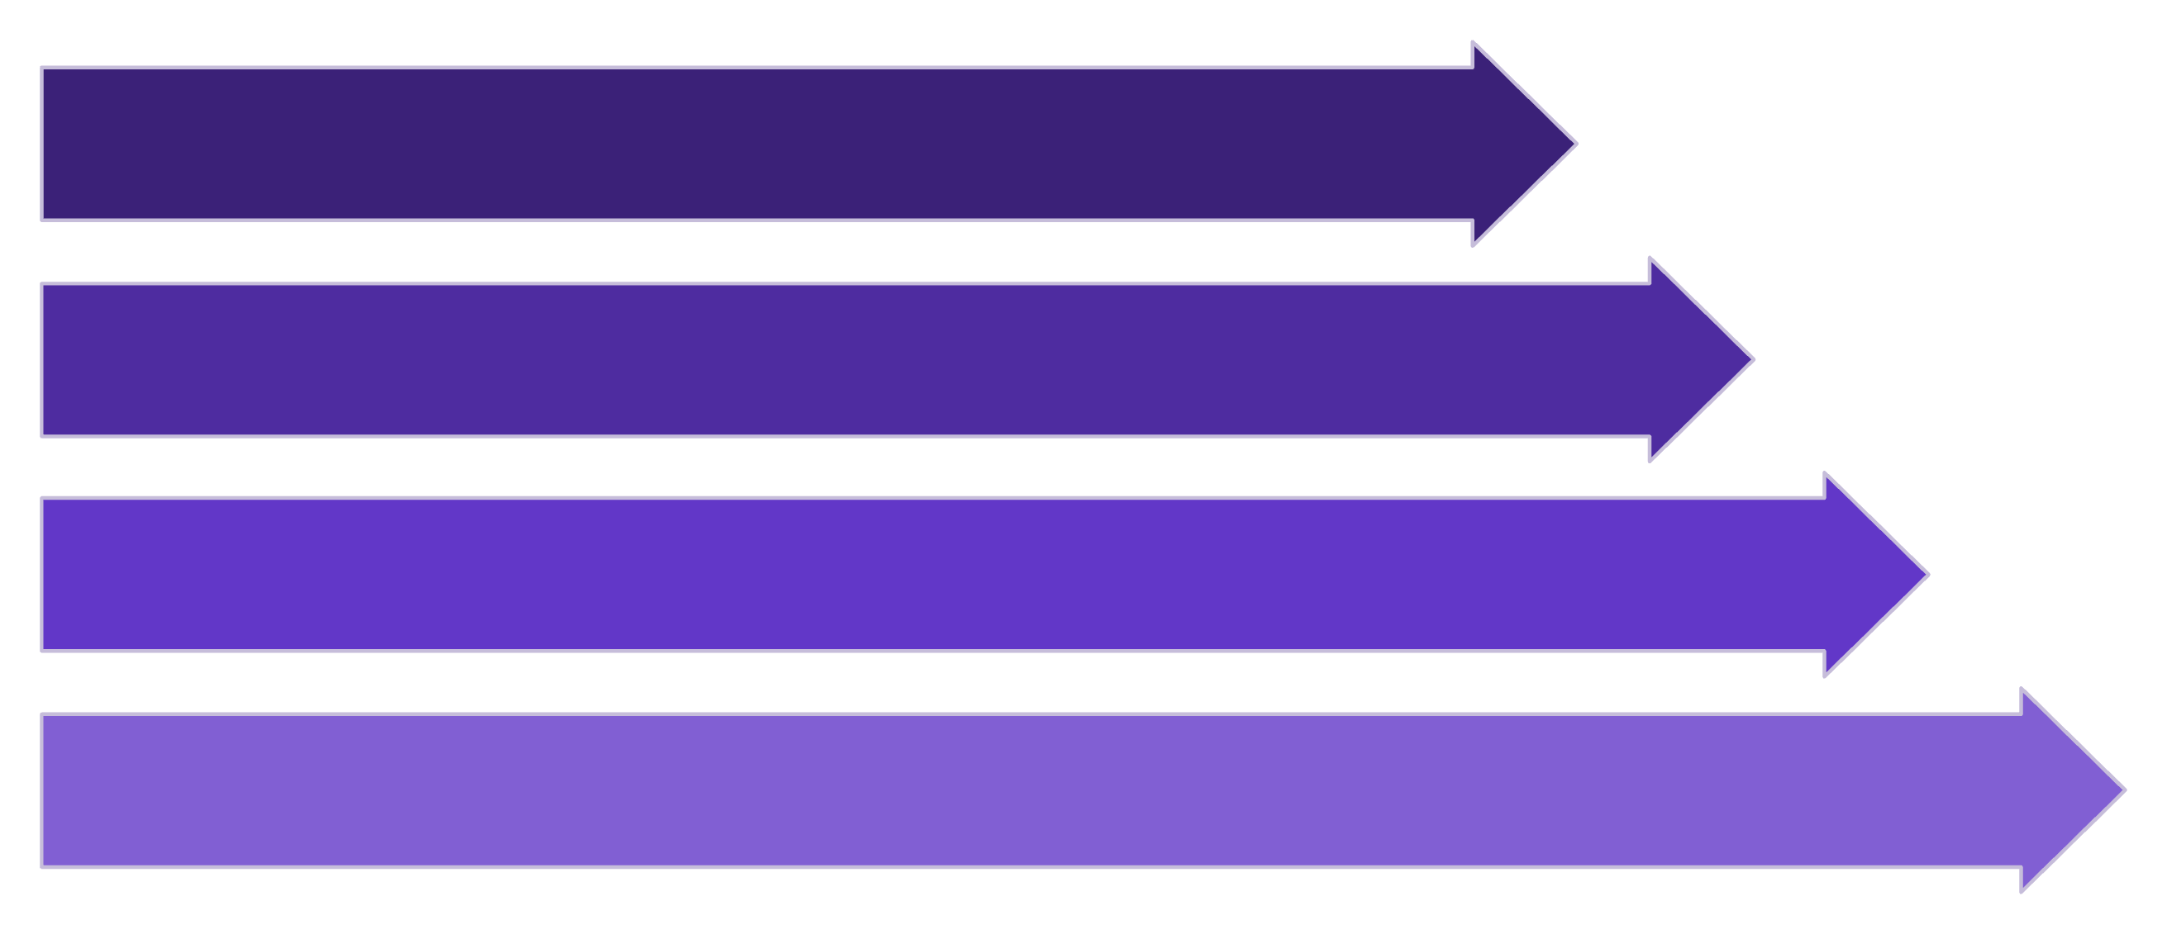
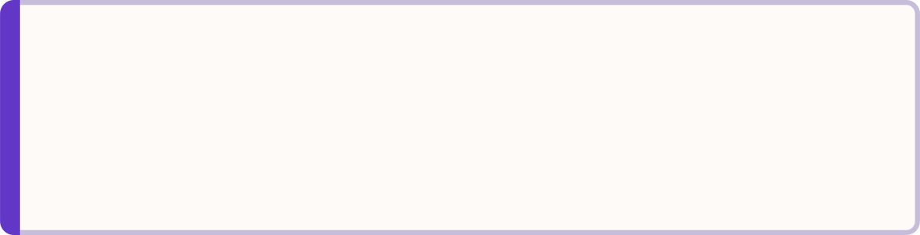
Sentiment Analysis & Text Classification
How It Works End-to-End
Real-World Applications
Sentiment in Action
Email
News
Support
Key Challenges
Spam / Not Spam detection
Sports / Politics / Tech routing
Complaint / Refund / Delivery routing
Sarcasm: "Oh great, another bug." — genuinely negative
Negation: "Not bad at all" — actually positive
Mixed sentiment: "Good product, awful delivery"
Domain language: Medical, legal, financial context shifts meaning
✅ Positive — Score: 0.91
➖ Neutral — Score: 0.06
❌ Negative — Score: 0.03
"I absolutely loved this product!"
"The product arrived yesterday."
"The service was terrible."

